Slide 1


Business Case
2026 Edition
Kick-off

Slide 2

Workshop 1 - Agenda
20 Feb 2026 | Duration
Introduction | 10 min
Intys Consulting | 5 min
Isolv methodology | 30 min
Business Case Overview | 20 min
Wow & Pre-requisite | 10 min
Q&A | 20 min
Business Case -2026 Edition

Slide 3
Introduction
Business Case -2026 Edition

Slide 4

Intys – Speaker’s Introduction​
Virassack Sisounol
+20 years experience
Delivery Management, Partner at Intys Consulting
Industrial liaison at ULB Qalinca Labs
Looking forward to share my experience with you
Business Case -2026 Edition

Slide 5
Intys Consulting
Intys Consulting presentation
Business Case -2026 Edition

Slide 6
intys at a glance.
At Intys, we prioritize: Performance, Responsibility, Courage, Self-Accomplishment
49.6M€
400+
200+
Our Edge: iSolv
Proprietary methodology, rooted in Lean Management.
18 years of application & continuous improvement.
Knowledge sharing across industries.
AI-powered for smarter, faster execution.
Always at the forefront
Intys Lab: co-creation & experimentation.
Pioneering in AI & Sustainability.
Innovative contracting models.
Academic partnerships: ICHEC & ULB (10+ years, real business cases).
consolidated turnover in 2025
collaborators as of end of 2024
clients
Intys is a European management consulting firm specializing in premium execution.
Since 2007, we have helped leading organizations translate strategic ambition into structured, measurable and lasting performance.
Powered by our proprietary iSolv standard and academic-backed rigor, we secure outcomes, giving leaders clarity, control and peace of mind.
1
intys.

Slide 7
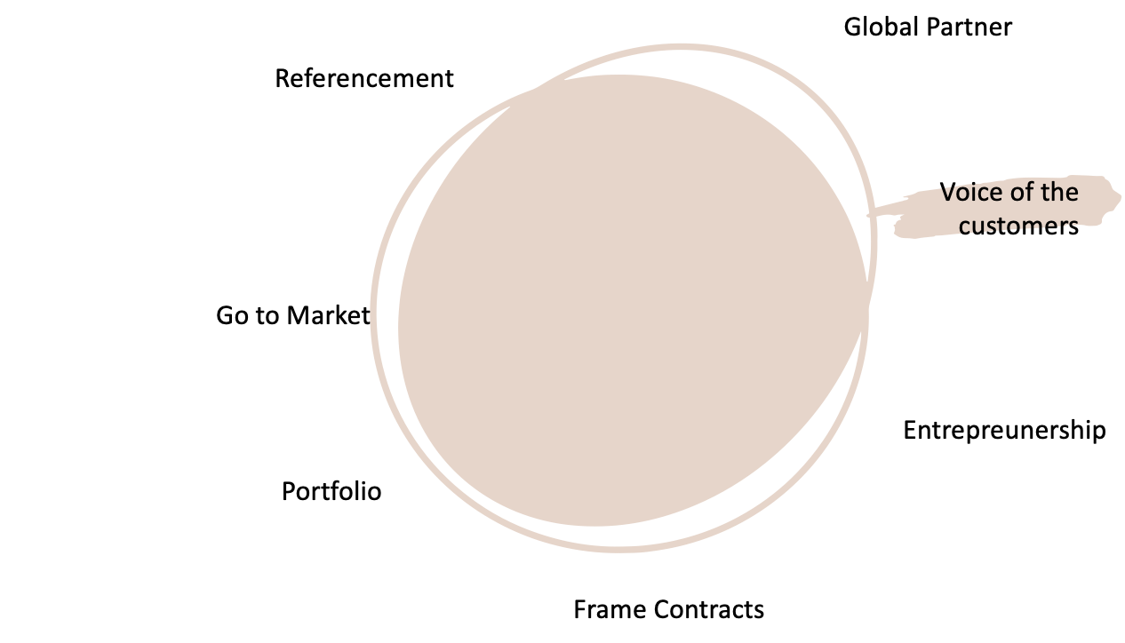
Strenghten our value proposition
We aim to positively impact
•processes & people,
•data
•Product
•Increase in maturity
•Move upmarket
•Our growth reflects the trust of our clients,
showcasing our ability to support
them in product and data development.
•Able to provide a holistic view
Customers & GTM
intys.

Slide 8
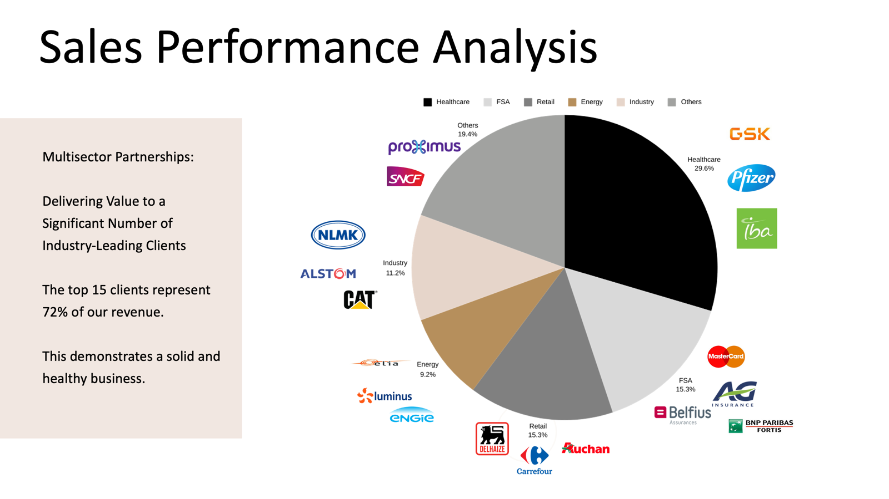

Slide 9

Our conviction
Intys was founded on a simple and demanding belief:
a strategy has no value unless it is executed.
For too long, consulting has focused on diagnosis, recommendations, and intellectual brilliance disconnected from operational reality.
Clients do not fail because they lack ideas.
They fail because execution is complex, fragile, and rarely industrialized.
Intys exists to close this gap.
intys.

Slide 10
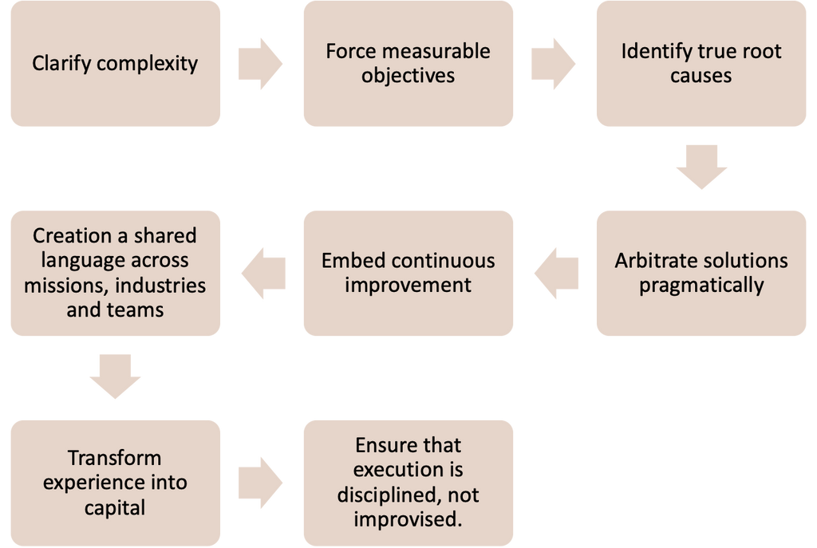
iSolv: our problem-solving backbone
At the heart of Intys lies iSolv.
iSolv is not a framework among others, is our operating logic for problem-solving and execution.
Its 8-steps structure:
ISOLV is how Intys thinks, decides and delivers.
onboarding 2026
intys.

Slide 11
iSolv Methodology
Theory & Best Practices
Business Case -2026 Edition

Slide 12








ISolv Methodology – 8 Steps
4. Analyze root cause
5. Develop countermeasures
3. Set the target
6. Implement
2. Break of the problem
7. Monitor progress
Phase 2: Action Plan
Phase 1: Mission Statement
Phase 3: Implementation
1. Clarify the problem
8. Capture lessons learned
intys.
The “Delivery Cycle”

Slide 13
Gap Analysis (2 ways)
Ideal situation
Gap
AS-IS
TO-BE
Current situation
Gap

Slide 14
Fishbone Diagram

Slide 15
SMART target
S
M
A
R
T
Specific
Measurable
Achievable
Relevant
Time-based
D
D
D
D
D

Slide 16
Business Case Overview
NutrYwell
Business Case -2026 Edition

Slide 17






NutrYWell Laboratories
Context
Rapid growth following the acquisition of a sports nutrition activity has increased portfolio complexity and pressure on NutrYWell’s Order-to-Delivery (OTD)performance.
Current State
A temporary Transitional Service Agreement (TSA) maintains business continuity but creates dual distribution logic, limited visibility, and reactive planning.
Key Issue
On Time In Full (OTIF) degradation, and firefighting indicate a fragile, effort-based operating model.
Question
How can NutrYWell redesign its OTD model to sustainably support its growth ambitions in a context of increased portfolio complexity and transitional distribution constraints?
Objective
Students are expected to:
Diagnose current OTD performance gaps
Identify structural root causes
Assess alignment between growth ambition supply chain capacity
Propose and prioritize short-term and mid-term supply chain levers
Design a roadmap supporting sustainable growth
Business Case -2026 Edition

Slide 18
Ways Of Working & Theoretical Pre-requisite
Workshop preparation
Business Case -2026 Edition

Slide 19







Ways of Working - Guidelines
Material will be made available in advance on Teams. Please read it carefully, assimilate the content, and conduct a preliminary analysis before the workshop.
Organise yourselves within your group. Collaborate and work together outside of the scheduled workshops.
Make sure you understand each week’s theoretical themes.
The workshop will focus on application
Come prepared to the workshops! Academic tourism not allowed!
Business Case -2026 Edition

Slide 20

Theoretical Pre-requisite
Students should ideally possess the following foundational knowledge:
End-to-End Order-to-Delivery : a clear understanding of the O2D process, including order entry, planning, production, distribution, and delivery. Students should be able to view performance from an end-to-end perspective rather than through isolated functional lenses.
KPI Interpretation and Performance Analysis: Ability to interpret and analyze key supply chain indicators such as OTIF, backorders, forecast accuracy, inventory turns, lead times, and capacity utilization.
Basic Planning Concepts: Familiarity with Make-to-Stock vs. Make-to-Order models, safety stock logic, lead times, minimum order quantities, and capacity constraints.
S&OP / IBP Conceptual Framework: a high-level understanding of S&OP as a decision-making forum and IBP as a multi-year anticipation mechanism linking strategy, planning, and execution.
Basic Network Design Awareness: understanding of distribution center roles, trade-offs between cost and service, and centralization vs. decentralization dynamics
Business Case -2026 Edition

Slide 21
ULB/Intys - Workshop Roadmap 2026
 | Date | Objectives
Kick off and program framing | Week 1 - 20/02/2026 (2h) | • Present the program framework and expectations • Introduce the Intys Methodology and the business case
Define Problem | Week 2 - 27/02/2026 (4h) | • Application Isolv 1/2/3/4 • Working time in groups • Presentation & Feedback
 | Week 3 - 06/03/2026 (4h) | • Application Isolv 1/2/3/4 • Working time in groups • Presentation & Feedback
 | Week 4 - 13/03/2026 (4h) | • Application Isolv 1/2/3/4 • Working time in groups • Presentation & Feedback
 | Week 5 - 20/03/2026 (4h) | • Diagnostic group presentation
Define Solution | Week 6 - 01/04/2026 (4h) | • Application Isolv 5 • Working time in groups • Presentation & Feedback
 | Week 7 - 08/04/2026 (4h) | • Application Isolv 6 • Working time in groups • Presentation & Feedback
 | Week 8 - 16/04/2026 (4h) | • Application Isolv 6/7/8 • Working time in groups • Presentation & Feedback
HOLIDAYS
Fine Tuning | Week 9 - 06/05/2026 (4h) | • Q&A
 | Week 10 - 13/05/2026 (4h) | • ​Presentation skills - tips and tricks​
 | Week 11 - 22/05/2026 (4h) | • Dry run of final presentations
EXAM | 08/06/26 | • Written reports
EXAM | 16/06/26 | • Final presentations
Business Case -2026 Edition

Slide 22


Questions ?

Slide 24
What is the vision ?
Why it matters:
It sets the direction and defines what success means.
Theory
Application : Emazon
Vision
Vision
Company’s long-term promise / value proposition
Be The world’s most reliable & customer-centric company
by
by
Mission
Mission
What the company does concretely to deliver that vision
Offering the lowest possible prices, the best available selection, and the utmost convenience.
Notes:
STORYTELLING OF THE VISION:
Picture a company at its best. A company where every department moves in the same direction. Where priorities are clear, decisions are coherent, and teams understand how their work contributes to something bigger.
This is the Vision , in other words the Ultimate Goal.
In simple terms (to emphasize):
The Vision is the long‑term ambition the organization is constantly striving for. It is about why the company exists and what future it wants to create.
Give the following examples to illustrate the vision:
Being the most trusted partner for customers
Leading the market in innovation or efficiency
Delivering excellence sustainably and consistently
Creating value for clients, employees, and stakeholders
TRANSITIONING TO THE MISSION OF A COMPANY
Explain the realities that a company faces, that hinders it from going towards the Vision : - Teams are overloaded. - Processes evolved faster than people. - Information flows in inconsistent ways. - Firefighting replaces improvement.
Although everyone is working hard… not everyone is working in the same direction.
That’s where the Mission enters the story.
STORYTELLING OF THE MISSION
It is the concrete contribution your client needs right now to move one step closer to their Vision.
Where the Vision asks “Where do we want to go?”, the Mission asks “What must be improved now to help us get there?”
In simple terms (to emphasize):
What we do today to move toward the Vision.
Give the following examples to illustrate the mission:
Reduce the reporting cycle from 8 days to 4 days
Improve communication flow across departments
Enhance data quality so decisions become faster and more reliable
Stabilize operations during a staffing gap.
Why we use “by” on the slide: it’s the bridge between the two. Vision = the destination / promise. Mission = the path / what we do. So we read it as: “We achieve the Vision by delivering the Mission.” If the Mission doesn’t sound like actions, then the “by” is wrong — it means the Mission is too abstract. KEY ARGUMENTS TO UNDERLINE
• Vision sets direction: it aligns priorities and defines what “success” means.
• Mission makes it actionable: it’s what we improve/do now to move toward the vision.
• We’ll use “by” to link them: Vision achieved by Mission.

Slide 25
Theory
Step 1: Clarify the problem
Purpose : Align with stakeholders on a fact-based definition of the problem.
To
CURRENT SITUATION
IDEAL SITUATION
“Where are we right now?”
GAP
(Problem)
“What do we want to achieve to contribute to the vision?”
“What is stopping us from getting to the ideal situation?”
Problem =
Ideal situation
-
Current situation
Output
A clear problem statement that describes the gap between current and ideal situation.
Notes:
STORYTELLING OF STEP 1:
In many companies, problems are perceived differently depending on where you stand:
Management sees strategic pressure (market share, compliance, cost).
Middle managers see operational bottlenecks.
Employees feel daily pain points.
When a consultant arrives, they hear all these versions at once — and each version sounds urgent.
Risk: Fixing what’s loudest and not what is important,
Before start Step 1,
1- Ask the room: ”what is a problem?” (Pick 3–4 attendees) 2- Acknowledge: “You see, definitions vary depending on perspective.” 3- For iSolv, we will use this definition today:
A problem is gap between a current situation and an ideal situation.
Step 1 forces the organization to pause and answer:
What is the company trying to achieve (Vision/Ultimate Goal)?
What does the department need to deliver to contribute to it (Ideal Situation)?
Where are we today (Current Situation)?
What is the real gap/problem (Difference between the ideal situation and the current situation)? -> To emphasize on
The gap should allow/help us to state a clear and concise mission statement.
Express the gap as mission statement using 5W2H: - What is happening?
- Where does it happen? (site, process step, team, country…)
- When does it happen? (period, frequency, peak moment…)
- Who is impacted?
- Why it matters? (impact, business impact, customer impact, risk)
- How does it happen? (how it manifests, typical scenario, triggers)
- How big is it? (How much? - volume, %, €, time)
Explain why it matters: - It creates a single, shared definition of “what we are solving and why.”
- Helps to avoid the company from wasting time in treating problems individually KEY ARGUMENTS TO UNDERLINE - “Ideal” and “Current” must be measurable, so everyone agrees on the gap. (Operational)

Slide 26
Best Practices
Step 1: Clarify the problem
Success criteria
Ideal & Current are measurable
Using the gap as reference, make your final mission statement using the 5W2H method
Gap is quantified (time, %, €, volume)
Focus on the facts, not opinions
(What, Who, Why, Where, When, How & How much)
Notes:
Objective of the slide :
Attendees practice on the Amazon case.
Questions:
- What is your ideal situation (measurable)?
- What is the current situation (measurable)?
- What is the gap (how much)? How big is it? Where/when?
- Can you give me your problem statement using 5W2H?

Slide 27

Application : Emazon
Step 1: Clarify the problem
Proposed solution
To
CURRENT SITUATION
IDEAL SITUATION
18% late deliveries
420k complaints
Complaint volume x3.5
Reactive operations
Capacity not saturated
GAP
Benchmark:<=3% late deliveries
Benchmark: 120k complaints
Stable operations
No firefighting
Proactive decisions
Late deliveries: +15% (percentage points)
Complaints: +300,000 extra complaints
Problem statement:
Emazon’s on-time delivery performance is currently lagging behind industry benchmarks by 15 percentage points compared to the ≤3% gap typically seen in the industry.
Notes:
OBJECTIVE OF THE SLIDE Our proposal for Step 1 on the Amazon UK case. (It’s not the truth; it’s a proposal that meets the Step-1 success criteria.)
The Ideal situation: what ‘good’ looks like in measurable terms (≤3% late deliveries, normal complaint level).
The Current situation: what we observe today (18% late, ~420k complaints).
The Gap: the difference +15% late deliveries = ~360k excess late orders; +300k extra complaints.
“And from that, we draft a one-line problem/mission statement: close this measurable gap by next peak season.”
5W2H — AMAZON UK STATEMENT
• What is happening?
Reduce late deliveries / excess late orders / complaints
•Where does it happen?
Amazon UK Boxing Day peak.
•When does it happen?
Before the next peak season (Boxing Day peak period - high-volume days).
•Who is impacted?
Operations, Logistics, Sales and UK customers (service level), Customer Service (customer experience and claim handling).
•Why it matters?
Protect customer trust. It damages customer trust and brand reputation, increases cost-to-serve, and creates operational instability (firefighting instead of controlled execution).
•How does it happen? (describe symptoms, not root causes) Delivery commitments are missed and complaints rise sharply as operations shift into reactive mode under peak pressure (plan changes, coordination overload, late prioritization decisions).
•How big is it? (How much?) Late deliveries: 18% vs ≤3% target (+15 pp) → ~360,000 excess late orders (2.4M × 15%). Complaints: 420,000 vs 120,000 (420 000/3,5) normal → +300,000 extra complaints.
Late deliveries: 18% – 3% = +15%
Orders: 2.4M × 15% = 360,000 excess late orders
Complaints: 420,000-120,000 = +300,000 extra complaints
5W2H – Gap-Focused Problem Statement
What: Late deliveries exceed target by +15% (18% vs ≤3%) Who: Amazon UK customers and delivery teams Where: Amazon UK delivery operations When: Peak season Why: Prevents Amazon from meeting its vision of being Earth’s most reliable and customer-centric company How: Misaligned priorities and unclear cross-team governance How much: ~360,000 excess late orders and ~300,000 additional complaints
KEY ARGUMENTS TO UNDERLINE • Everything here is measurable (%, volumes) — not opinions.
• The gap is quantified so we can prioritize later.
• This statement sets a shared definition of the problem before we break it down (Step 2).
• Again: this is a proposal I can challenge it if disagree.

Slide 28
Theory
Step 2: Breakdown of the problem
Purpose : Decompose the problem and make it manageable.
Large Problem
1
Decomposition
Category 1
Category 2
Category 3
2
Priorization
Prioritized sub-problem (P1)
Output
A prioritized problem to focus on.
Notes:
STORYTELLING OF STEP 2
In companies, the biggest danger is not misunderstanding problems — it is understanding them too broadly.
It is usually the visible result of many smaller dysfunctions hidden at different levels, such as:
Processes
Roles
Tools
Habits
Step 2 prevents that. How we turn one big problem into manageable sub-problems, and how we choose one prioritized focus?
Breaking down the problem requires 2 steps:
Segmentation → a full, structured picture of the problem
In simple terms (to emphasize):
It allows the problem to be cut into manageable pieces.
2) Pondération → a sharp, focused selection of what to solve first
In simple terms (to emphasize):
Not all sub-problems matter equally, and it is a business decision about where to allocate effort .
1) WHY SEGMENTATION IS IMPORTANT:
In business, when a problem is too large, it becomes abstract. People talk in fuzzy terms:
Examples of fuzzy terms:
“The reporting is bad.”
“The process is too slow.”
“The team is overwhelmed.”
“The system doesn’t work.”
Segmentation is crucial because (to emphasize):
It removes ambiguity
It prevents oversimplification
It brings all stakeholders to a shared, factual understanding
It reveals that some sub‑problems belong to other teams or functions
In simple terms (to emphasize):
It allows the problem to be cut into manageable pieces.
2) WHY PONDERATION IS IMPORTANT:
Once the problem is properly segmented, the company sees something important:
Some sub-problems are inconvenient… But others are decisive.
Some elements are:
Business‑critical
Costly
High‑impact
High‑risk
Sources of major inefficiencies
Closely linked to the strategic gap
This is where pondération matters.
The organization must decide:
Where the mission must focus first
What will deliver the biggest impact
What is realistic given time, resources, and constraints
Prioritization provides clarity on what to tackle first.
OUTPUT expected: a single or set of problem that will be tackled after segmentation and prioritization.

Slide 29
Best Practices
Step 2: Breakdown of the problem
Success criteria
Use one clear lens to decompose using Problem tree or Fishbone method
Prioritize using weighted scoring using Impact/Effort/Risk or Pareto method
Select one primary focus before going deeper
Notes:
Objective:
The goal is to break down the Step-1 gap into sub-problems, then use pondération to select one prioritized focus.
Questions to ask:
Which lens did you choose and why?
What are your 3–5 subproblems?
How did you weight them (criteria)?
Which one is P1 and what number/fact supports it?

Slide 30
Application : Emazon
Step 2: Breakdown of the problem
Proposed solution
Late deliveries (+15% gap)
Excess orders
(30%)
No clear rules to prioritize premium/urgent orders
(50%)
Operational firefighting
(20%)
Impact: Medium
Effort: High
Risk: Medium
Impact: High
Effort: Medium
Risk: High
Impact: Medium
Effort: High
Risk: Medium
Prioritized subproblem
Notes:
APPLICATION OF STEP 2:
In Step 2, our goal is to decompose a very large problem into smaller, manageable components. For Amazon UK, the high‑level problem was +15% late deliveries during Boxing Day.
If we keep it at that level, it’s impossible to act — it’s simply too big and too vague.”
**“So we break it down using three lenses:
- demand and planning issues,
- governance and prioritization issues,
- operational execution symptoms.”**
“On the left, we see the upstream causes like forecast instability and excess orders. These create noise but they do not, by themselves, explain the multi‑day delays. Capacity was NOT saturated, so this is not the strongest driver.”
“On the right, we see operational firefighting. Again, these are symptoms of something deeper. Firefighting is a consequence of unstable decisions and unclear rules.”
“The middle branch is the real structural blocker: Amazon teams had no clear rules to prioritize orders and conflicting priorities between Sales, Logistics, and Operations. This means that during peak execution, every team was pushing its own priorities — without a single decision owner and without frozen rules.”
“To prioritize, we use an Impact/Effort/Risk logic:
We evaluate each sub‑problem on:
Impact on late deliveries
Effort required to solve
Risk of not addressing it
1️⃣ Excess orders (+35–45%) / Forecast constantly changing
Impact: Medium (creates fluctuations but capacity was not saturated)
Effort: Very high—requires structural forecasting overhauls
Risk: Medium—fluctuations will continue but won’t alone create 15% late
2️⃣ Operational firefighting / No escalation owner
Impact: Medium—symptoms of upstream misalignment
Effort: High—requires major behavioural and process changes
Risk: Medium—continues to cause local inefficiencies
⭐ 3️⃣ No clear prioritization rules + Conflicted priorities
Impact: Very High → This directly creates multi‑day delays, last‑minute decisions, and flow instability.
Effort: Medium/Low → Governance rules, ownership, and meeting structures are organizational levers (easier than systems or forecast changes).
Risk: Very High → If not fixed, Boxing Day 2026 will repeat exactly the same pattern.
– Governance misalignment has the HIGHEST impact on multi‑day delays, – It is easier and faster to fix than forecasting or structural capacity changes, – And if we don’t solve it, we guarantee the next Boxing Day will fail again.”
“This is why our prioritized sub‑problem — P1 — is the conflict of priorities and lack of clear rules. It is the root of the instability, the multi‑day lateness, and the customer dissatisfaction. Fixing this one lever creates the most leverage for the mission.”

Slide 31



Theory
Step 3: Set the target
Purpose : Establish clear goals to guide actions and decisions.
With a Target:
DIRECTION
%
CLARITY
(Alignment meeting )
MEASURABLE
Crucial to have this meeting with all stakeholders
Why it matters:
To create alignment and prevent teams from solving acting independently.
Notes:
STORYTELLING OF STEP 3 “Set the target”:
it is about decision‑making. It converts the problem into a future performance level that everyone recognizes and supports.
At its core, the theory behind setting the target rests on three principles:
PRINCIPLE 1 – TARGET CREATES DIRECTION
Problems describe what is wrong; Targets describe where the organization must go.
Without a target, teams act, but do not know whether they are moving in the right direction, or fast enough, or far enough.
A target acts as a point of convergence.
It aligns:
strategic ambition (Step 1)
operational reality (Step 2)
future expected performance
Targets turn analysis into a trajectory.
PRINCIPLE 2 – TARGET CREATES CLARITY
Step 3 transforms that understanding into commitment.
A target forces stakeholders to confront crucial business questions:
How much improvement is acceptable?
How fast?
What trade‑offs are possible?
What resources should be mobilized?
What risk level is tolerable?
What baseline are we starting from?
Targets remove ambiguity; they force clarity.
PRINCIPLE 3- TARGET CREATES MEASURABLE VALUE
The company invests time, money, and people in the improvement effort. A target exists to ensure a return on that investment.
A well‑defined target provides:
a performance benchmark
a monitoring reference point
a basis for accountability
a way to evaluate success
a justification for decisions taken later
A mission without targets is like a budget without numbers: intentions exist, but value cannot be demonstrated.

Slide 32
Best Practices
Step 3: Set the target
Success criteria
Set the target using the SMART method.
Clearly address the prioritized sub-problem and not a different scope.
Each target is measurable with a precise metric, a baseline, a scope.
Targets are controllable and external dependencies are stated as risks.
(Specific, Measurable, Achievable, Realistic, Time bound)
Notes:
Questions:
What are your target?
What’s the baseline and the exact metric definition?
Is it feasible in the timeframe?
Does it depend on external parties?

Slide 33
Application : Emazon
Step 3: Set the target
Proposed solution
Target:
Reduce late deliveries from 18% to the benchmark level of ≤3% by next Boxing Day, by clarifying prioritization rules internally.
Target | Specific | Measurable | Achievable | Relevant | Time bound
T1 | Improve delivery performance | Late deliveries 18% → ≤3% (360k fewer late orders) | Based on planning fixes + rules (in scope) | Contributes to vision (customer satisfaction) | By next Boxing Day
Notes:
Step 3: Set the Target
**“In Step 3, our role is to transform the breakdown analysis into a clear definition of what ‘success’ must look like. The pre‑read showed us two things:
Amazon UK suffered a visible performance failure — 18% late deliveries versus a normal level under 3%.
This failure was amplified by structural governance issues, not by capacity constraints.”**
“So when we set the targets, we deliberately separate two types of objectives: – A performance target (T1), which closes the quantified delivery gap, – And a governance/behavioral target (T2), which prevents the chaos described in the pre‑read.”
“For T1, we don’t simply restate the gap of +15 points. The target is not ‘reduce the gap by 15%’, because the purpose of a target is to define the future desired state. So we express it as: ‘Late deliveries reduced from 18% to ≤3% by next Boxing Day.’ That aligns directly with Amazon’s promise of fast and reliable delivery.”
“For T2, we address what the pre‑read highlighted as the structural issue: conflicting priorities, no rules, and constant last‑minute changes. This is why the second target is: ‘Zero last‑minute prioritization changes after the cutoff during the peak execution window.’ This directly stabilizes decision‑making and prevents the firefighting pattern we saw last year.”
“We then apply the SMART method to make both targets robust: – Specific: we define precisely what changes – Measurable: % of late deliveries, count of changes after cutoff – Achievable: based on governance levers, not unrealistic system changes – Realistic: focused on the prioritized sub‑problem, especially 2+ days delays – Time‑bound: deadline = next Boxing Day or during the peak window”
“With these targets in place, the mission now has a clear direction and shared expectations. This alignment is essential before moving to Step 4 and Step 5.”

Slide 34
Theory
Step 4: Analyze root cause
Purpose : Understand why the problem exists.
1
“Which problem are we analyzing ?”
→ Prioritized subproblem (step 2)
2
3 rules to identify the root cause of the problem:
Identify the point of occurrence
Actionable / In our control
Avoid symptoms
Output
A root cause on which we can act upon to help achieve the target.
Notes:
STORYTELLING OF STEP 4:
“If we don’t understand why the problem happens, improvements won’t last.”
(EXPLAIN AND GIVE SEVERAL EXAMPLES BELOW) Many companies fix issues by applying quick patches:
More manual checks
Additional meetings
Temporary staff
Escalations
These create activity — but not improvement.
Root cause analysis forces the organization to investigate:
What is structurally broken in the process?
What triggers the issues?
Where exactly does the problem occur?
What internal habits or constraints reinforce it?
And most importantly: - Are we solving the cause or just the consequence?
💼 Why it matters Because sustainable improvement only happens when the organization stops fighting symptoms and starts attacking the mechanisms that generate them.
> INPUT = prioritized sub-problem (P1) from Step 2.
> OUTPUT = actionable root cause within our span of control.
INTERACTION: Ask 2–3 people: What is the goal of root cause analysis? Our definition: Step 4 means finding the cause we can control act on, not a symptom.
Example:
Use the leg pain metaphor to anchor:
Paracetamol = symptom relief
Plaster = root cause fix
Explain the two criteria to emphasize:
Actionable / in our control : “Work on the cause that is within our span of control.”
Avoid symptoms : “Make sure we don’t stop at a symptom.”
Explain the method toolset:
To get there, we typically use:
5 Whys (Main tool)
sometimes Fishbone (Alternative/complement)
or combine both (when useful)

Slide 35
Best Practices
Step 4: Analyze root cause
Success criteria
The 5 Whys are fact-based and logically consistent, not opinion-based.
The final root cause is actionable within our span of control.
The root cause prevents recurrence and is not just a symptom.
Identify the point of occurrence.
Notes:
Objective: This is the application moment: we practice Step 4 and check it against criteria.
Facilitator script (say it)
Quick reminder: we’re not looking for a smart story; we’re looking for a cause we can act on.
Your output is one actionable root cause, not five symptoms.
Exercise instructions (5 minutes)
Write the P1 problem statement in one sentence.
Do 3–5 Whys with facts only.
Circle the first ‘Why’ that becomes actionable and in scope.
Be ready to justify leverage: why is this the best place to act?
Success criteria (tie to your 3 bullets)
5 Whys: each why is a cause, not a complaint.
Leverage: pick the cause that would remove the most recurrence.
In scope: if it needs enterprise approval, it’s not your root cause.
Debrief questions
“Which ‘Why’ is a symptom?”
“Which ‘Why’ is outside your control?”
“What evidence would you need to validate this root cause?”

Slide 36
Application : Amazon UK
Step 4: Analyze root cause
Proposed solution
Prioritized subproblem:
No clear rules to prioritize premium/urgent orders
1st Why
2nd Why
3rd Why
4th Why
5th Why
D
D
D
D
D
Conflicting priorities between Sales, Logistics and Operations.
No single accountable owner for peak-season governance.
Peak-season execution is not treated as a structured end-to-end process
No agreed end-to-end prioritization framework
Peak-season rules are not formally defined and validated.
Span of control
Enterprise
Notes:
Objective: We show the 5 Whys outcome, and we highlight the actionable root cause we will act on.
Quick reminder Our goal is not to treat symptoms, but to identify a root cause we can control.
Span of control (important)
The 4th Why (“no single accountable owner”) is outside our control, because it requires a leadership decision.
The actionable root cause in our scope is the 3rd Why: “Peak-season rules are not formally defined and validated upfront.”
Why this is the leverage point If rules are defined and validated upfront, teams don’t need to re-arbitrate during execution, which reduces last-minute prioritization and firefighting.

Slide 37
Theory
Step 5: Develop Counter-measures
Purpose : Design solutions that directly address the root cause(s).
Design solution: generate options “if no constraints”
Decide best option: apply constraints and criteria to select
 | Hard constraints |  | Soft constraints
 | Constraint 1 | Constraint 2 | Constraint 3 | Constraint 4 | Constraint 5
Countermeasure 1 | V | X | V | V | O
Countermeasure 2 | X | X | X | V | X
Countermeasure 3 | V | V | V | O | V
Feasible V Potentially O Rejected X
Output
A validated decision + mandate (sponsor approval) to implement.
Notes:
STORYTELLING FOR STEP 5
After Step 4, the company finally knows why the problem exists.
Thanks to the root cause analysis, the organization sees the real mechanism behind the issue:
GIVE EXAMPLES BELOW (to emphasize on):
Broken process
Missing input
System limitation
Governance flaw
Resource gap
To emphasize on :
At this stage, the company will think or say “Now that we understand the real cause, what can we do about it?”
Principle 1 — A root cause is only useful if it triggers a concrete action
Identifying “the cause” is intellectually interesting, but operationally useless until the company asks:
Step 5 is the moment where theory becomes transformation.
Principle 2 — Solutions must be chosen consciously, not instinctively
Even if only one solution is viable, the company must still confirm:
feasibility
effort
cost
roles
governance
risks
stakeholder impact
Explain (to emphasize):
When designing solutions, it important to analyze the constraints of the company and integrate them when choosing the best options/solutions.
PURPOSE
Step 5 is about designing countermeasures that address the root cause, then selecting one.
Two phases
Design solutions: “If we had no limits, what options could solve the root cause?”
Decide best option: “Now we apply constraints and decision criteria to select.”
Constraints and who decides Constraints come from the client/sponsor/management (budget, legal, tech, capacity). The consultant proposes options, but the sponsor validates constraints and choice.
Hard vs soft constraints Hard constraints are non-negotiable (e.g., legal, budget cap, cannot change core system). Soft constraints are preferences and trade-offs (e.g., comfort, minor workload, timing).
How to interpret V / O / X V = valid option (respects hard constraints and fits the scope). O = unclear option (needs stakeholder validation or negotiation on soft constraints). X = rejected option (breaks a hard constraint, so we don’t implement it).
Key output At the end of Step 5, the key output is a decision + mandate: the sponsor approves the selected countermeasure and gives authority to execute. Without this mandate, Step 6 (implementation planning) cannot start.

Slide 38
Best Practices
Step 5: Develop Counter-measures
Success criteria
Generate at least 3 countermeasures for the same root cause.
List hard and soft constraints agreed with the sponsor.
Compare options in a feasibility matrix and select the best fit.
Justify the selected option with facts, trade-offs, and constraints.
Notes:
Transition “Now that we have an actionable root cause, we move to Step 5: countermeasures.”
Success criteria (A–D) A: We propose at least 3 options for the same root cause. B: We identify hard vs soft constraints set by the client/sponsor. C: We use a feasibility matrix to compare options and choose one. D: We justify the choice with facts and clear trade-offs.
Exercise (5 minutes)
Write 3 countermeasures for the root cause.
Write 2 hard constraints + 2 soft constraints.
Fill a quick feasibility matrix (V / O / X).
Pick one option and prepare a 1-sentence justification.”
Debrief “I’ll ask 2–3 people:
What options did you generate?
What were your hard constraints?
Which option did you pick and why?”
Feedback “As you answer, I’ll check A–D with you, then I’ll show our proposal.”

Slide 39
Application : Emazon
Step 5: Develop Counter-measures
Proposed solution
 | Hard constraints |  |  | Soft constraints
 | Time bound | Legal | Delivery promises | Manual intervention | Budget | Cross-team collaboration
Peak-season freeze calendar | V | V | V | X | O | O
Peak-season Rulebook | V | V | V | O | O | V
Escalation Rule + RACI | V | V | V | O | O | O
Daily Peak War Room | V | V | O | O | V | O
Full process redesign | X | O | X | O | O | X
Notes:
WHY THOSE CONSTRAINTS:
Time bound : Live before Boxing Day Implied strongly by the case. Boxing Day is a fixed event, with limited time to prepare; the case stresses time pressure and the need for solutions that can be set up upstream.
No core IT change Mostly implied by the case + reinforced by logic. The case pushes governance/alignment over big structural rebuilds (and the trainer doc explicitly says governance doesn’t require new tools/systems).
≤ Budget limit Not in the Amazon storytelling as a specific number (budget is a standard hard constraint, set by sponsor/client). He even warns that budget can be tricky in a fast-training case.
Limits Sales flexibility Directly from the storytelling. “Any solution would inevitably limit Sales flexibility.” Your rename to “Sales acceptability” is just the positive phrasing of the same trade-off.
Resists bypass under peak stress Directly from the storytelling. The file literally says rules get bypassed without buy-in and that solutions enforce rules under peak stress.
Change effort / training load Not explicitly listed in the storytelling bullets, but consistent with your Step 5 criteria (“pragmatic / immediately applicable”) and your Step 6 content includes training/supervisors. So it’s a reasonable soft constraint to compare options.

Slide 40
Theory
Step 6: Implement
Purpose : Turn solutions into actions.
Step 5:
Step 6:
Decision Making/
Mandating
To
Executing
1
Who does what? (RACI table)
2
When? (Gantt Chart, Roadmaps)
Notes:
STORYTELLING OF STEP 6
“Countermeasures have been decided , now it’s time to execute what has been decided
Companies often have excellent solutions but lack clarity on:
Who does what
When
With what resources
With what level of authority
How progress will be communicated
How obstacles will be escalated
RACI and Gantt provide structure, visibility, and predictability. This is where the organization moves from intention to action.
💼 Why it matters Because processes do not change by themselves — people change them. This step ensures the organization is equipped and aligned to actually implement what was designed.
OUTPUT: A concrete plan of who does what and when

Slide 41
Best Practices
Step 6: Implement
Key giveaways and tips
Make sure the timeline for each task is realistic.
Assign roles & responsibilities (RACI method)
Visualize the timeline with all the task to implement (Gantt Chart or Roadmap)
(Things to consider: Mission duration, skills, stakeholders' capabilities, available staff etc…)
Notes:
RACI and Gantt provide structure, visibility, and predictability.

Slide 42


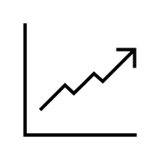
Theory
Step 7: Monitor Progress
Purpose : Track performance and enable timely decision-making.
ACTION
IMPACT
Monitoring
Bridge between action/execution & impact
How?
Tools & systems (Dashboards, KPIs, Reporting tools…)
“Which tool/system will allow me to best track and evaluate the impact of the solutions I implemented?”
Notes:
STORYTELLING OF STEP 7:
“Improvement is only real if visible.”
Projects often launch strong and then fade away. Daily priorities take over. Teams revert to old habits.
Monitoring puts discipline in the system:
KPIs
Dashboards
Touchpoints
Communication loops
Early detection of deviations
Adjustments when something doesn’t work
It keeps management and operational teams aligned on progress.
💼 Why it matters Because without monitoring, even the best implementation loses momentum. This step protects the change until it becomes business as usual.

Slide 43
Best Practices
Step 7: Monitor Progress
Success criteria
Have only a few KPIs that are key
Build a governance framework around these KPIs (ex: Dashboards, Touchpoints..)
Define clear thresholds & pre-agreed actions
Monitor adoption of rules or solutions
Notes:
KPIs
Dashboards
Touchpoints
Communication loops
Early detection of deviations
Adjustments when something doesn’t work

Slide 44


Theory
Step 8: Capture Lessons Learned
Purpose : Convert experience into organizational learning.
Projects produce results, but learning produces organizational maturity. Without capturing lessons learned, mistakes reappear and improvements are temporary.
Lessons learned should ensure:
1
Continuous improvement
2
Sustainability
Notes:
STORYTELLING OF STEP 8
“Organizations grow by learning”
After delivering results, companies often rush to the next project. But experience is lost, mistakes reappear, and teams repeat the same patterns.
Lessons learned formalize:
What worked well
What created obstacles
What risks really mattered
What should be done differently next time
What improvements remain open
What new opportunities emerged
This step converts a project into a knowledge asset for the entire organization.
💼 Why it matters Because this is how companies build maturity, avoid repeating mistakes, and continuously improve their methods and performance.

Slide 45
Best Practices
Step 8: Capture Lessons Learned
Success criteria
Identify key behavioral and structural changes during the mission
Ensure a good handover to avoid recurrent patterns (ex: documentation)
Include lessons into existing routines (ex: reusable templates, checklists)
Notes:
Briefly summarize each point, and emphasize that these criteria are key in capturing lessons and to avoid repeating these mistakes in the future

Slide 46
Best Practices tools to print

Slide 47
ISolv Methodology – 8 Steps
4. Analyze root cause
5. Develop countermeasures
3. Set the target
6. Implement
2. Break of the problem
7. Monitor progress
Phase 2: Action Plan
(after alignment meeting)
Phase 1: Mission Statement
(within the first 6 weeks)
Phase 3: Implementation
(after Action Plan)
1. Clarify the problem
8. Capture lessons learned
intys.
The “Delivery Cycle”
(After Lessons Learned/ Starting a new project)

Slide 48
Problem tree
Large / Vague Problem
Problem 1
Problem 2
SubProblem
SubProblem
Problem 3
SubProblem
Prioritized
SubProblem
SubProblem

Slide 49
5 Whys
Prioritized problem:
D
1st Why
2nd Why
3rd Why
4th Why
5th Why
D
D
D
D
D

Slide 50
Feasibility table (Develop Countermeasures)
Root cause | Counter measures | Finance | Legal | HR | Maintenance | To be implemented
(Root cause) | (Countermeasure 1) |  |  | X | O
 | (Countermeasure 2) |  |  | Δ | Δ
O: OK
Δ: To negotiate
X: not OK

Slide 51
RACI (R=Responsible, A=Accountable, C=Consulted, I=Informed)
Activities/ Ressources | Role 1 | Role 2 | Role 3 | Role 4 | Role 5
Task 1
Task 2
Task 3
Task 4

Slide 52
Gantt Chart
 | Week 1 | Week 2 | Week 3 | Week 4 | Week 5 | Week 6 | Week 7
Task 1
Task 2
Task 3
Task 4

Slide 53
Simple roadmap
Phase 2: Second milestone
Phase 3: Third milestone
Phase 1: First milestone
Phase 4: Fourth milestone
- Actions
- Actions
- Actions
- Actions

